Slide 1

Image Processing Tool: Version 2.0
The A Team
Sanan Aamir, Romando Garcia,
Anne Lam, James Rowe, Hieu Tran
Final Presentation
March 4, 2015

Slide 2
Outline
Introduction
System Architecture
Version 1.0 and new objectives in Version 2.0
Plan
Organization
Work-to-date and Future Work

Slide 3
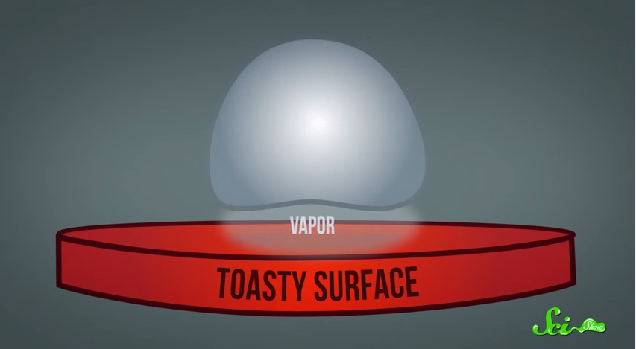
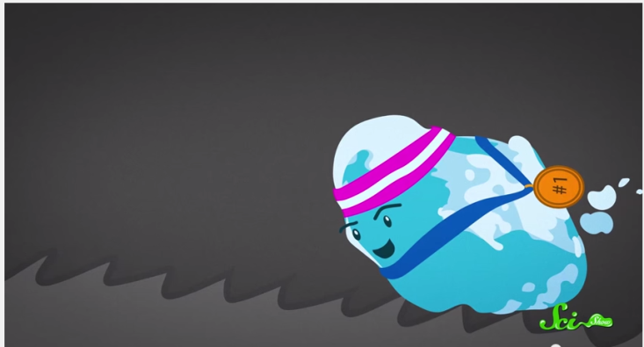
Introduction
The Leidenfrost Effect
Heating a liquid droplet above its boiling point creates a vapor pillow of its own gases underneath it
With little friction between vapor and surface, slight disturbances move the droplet
Ratchet surface gives just the right disturbance to control the movement
Notes:
Description of problem / user's work context -25%
Plan -10%
Process Model -5%
Team Organization -5%
Interface Design and System Design -25%
System to date/ What still is left -5%
Organization of presentation -10%
Creativity -15%

Slide 4
Our objective
Potential uses in micro-cooling
Customers, Dr. Ok and Dr. Guo, require data on droplet kinetics
Collect data from images taken through high-speed camera

Slide 5
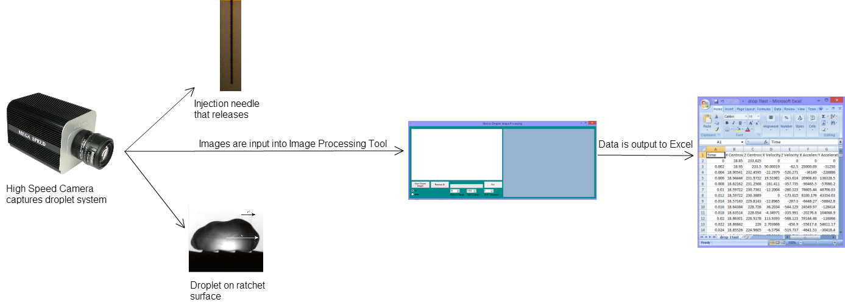
System Architecture

Slide 6
Previous Version
Loaded folder of images
Initially determined needle and surface location by using base image (no droplet)
From determination, was able to isolate the drop and calculate centroid, velocity, and acceleration at each image point
Created .csv file with data

Slide 7
New Objectives
Remove use of base image
Calculate drop volume
Generate graphs for velocity and acceleration as a function of time
Clean up code (unreadable)
Make system more automated (less user interaction) and faster
Conversion of pixel units to real-world units

Slide 8
Big-Picture Plan
Start new project with OOP structure and utilize working components from Version 1
Re-design GUI
Use multithreading to maximize processing speed

Slide 9
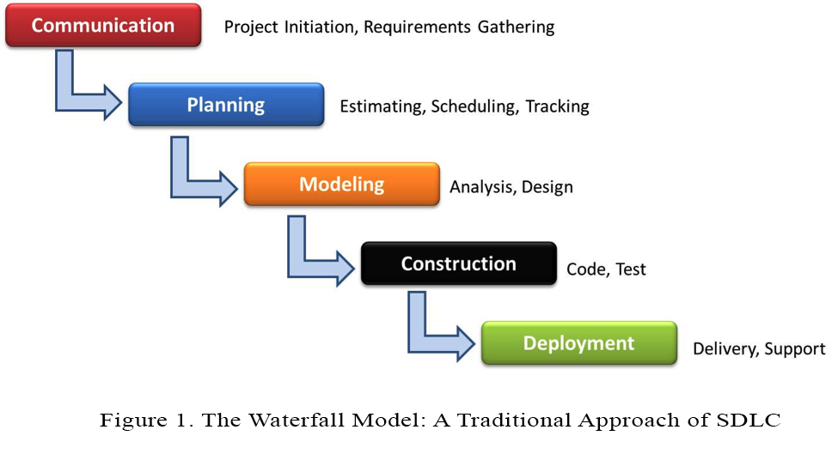
SDLC: Waterfall Model
Simple use and easy to understand style
Requirements well established and unlikely to be significantly changed

Slide 10
Team Organization
James Rowe as Team Leader
Controlled, Decentralized
All members contribute to documentation via primary authoring or editing
Coding split based on functionality,
Two pairs of partners focusing on a set of features
James/Romando Garcia and Anne Lam/Sanan Aamir
Hieu Tran - testing and documentation

Slide 11
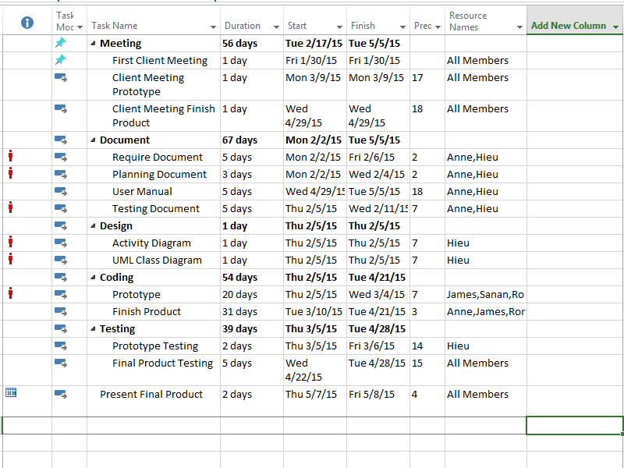
Additional Plan Details
Visual Studio & C#
Github for Version Control and Project Storage
Communicate often, formal meetings weekly
Task Network Diagram

Slide 12
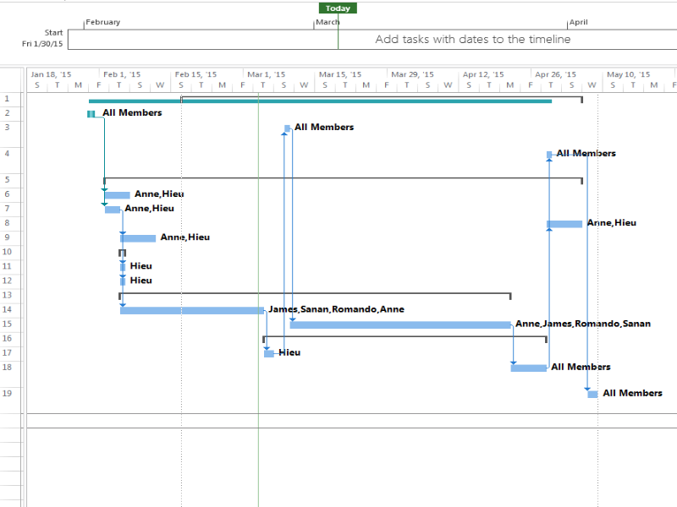
Time Line

Slide 13
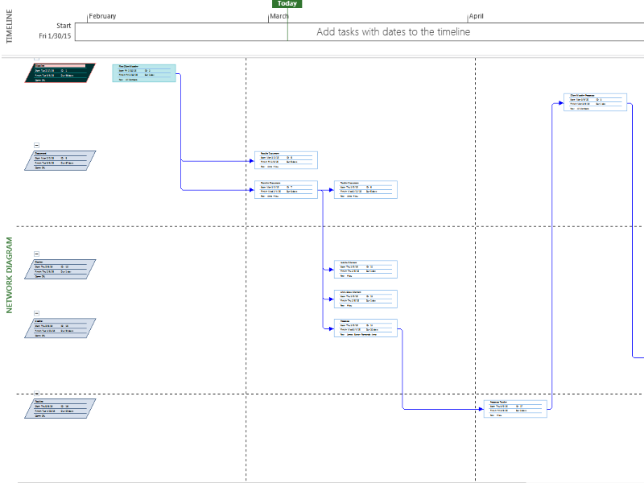
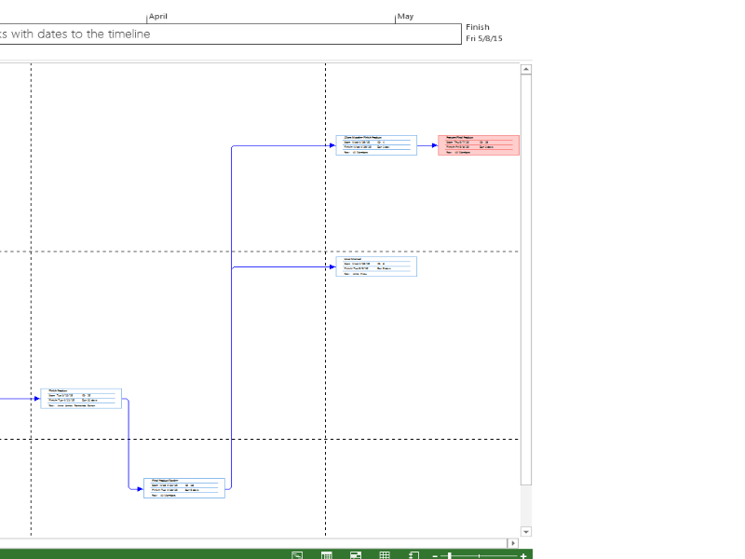
Network Diagram

Slide 14
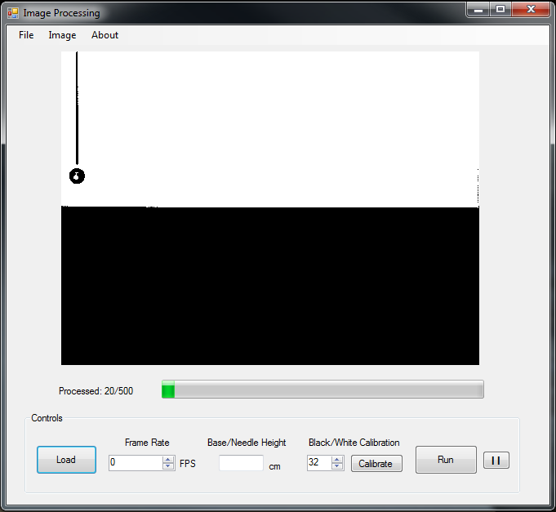
Interface Design

Slide 15
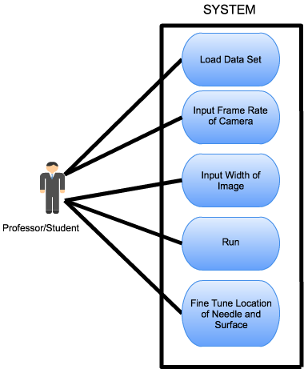
UML Use Case Diagram

Slide 16
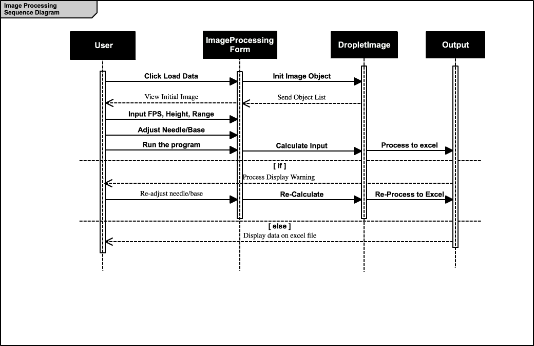
UML Sequence Diagram

Slide 17
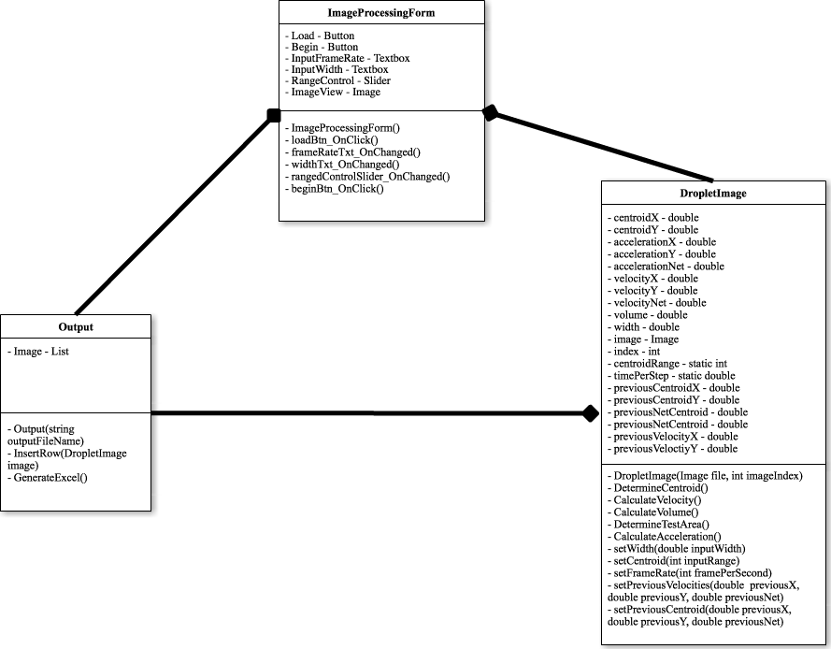
UML Class Diagram

Slide 18
Conclusion
Accomplished
Requirement Documents
Planning
Meetings with Client
User Interface
Diagrams
Future Work
Prototype
Testing
Testing Document
Final Product
Final Product Presentation

Slide 19
References
"The Leidenfrost Effect: How to Make a Liquid Levitate." YouTube. YouTube, n.d. Web. 10 Mar. 2015.
Questions?

Slide 20

Demo

